Slide 1
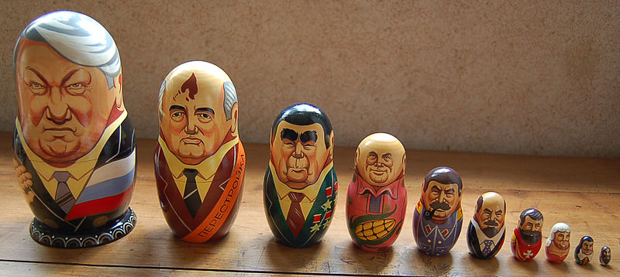
Collections of Sets
1990s matryoshka set featuring Russian leaders and demonstrating the bald–hairy sequence.
Discrete Structures (CS 173)
Madhusudan Parthasarathy, University of Illinois

Slide 2
Today’s class
Collections of sets: basics
Review of midterm

Slide 3
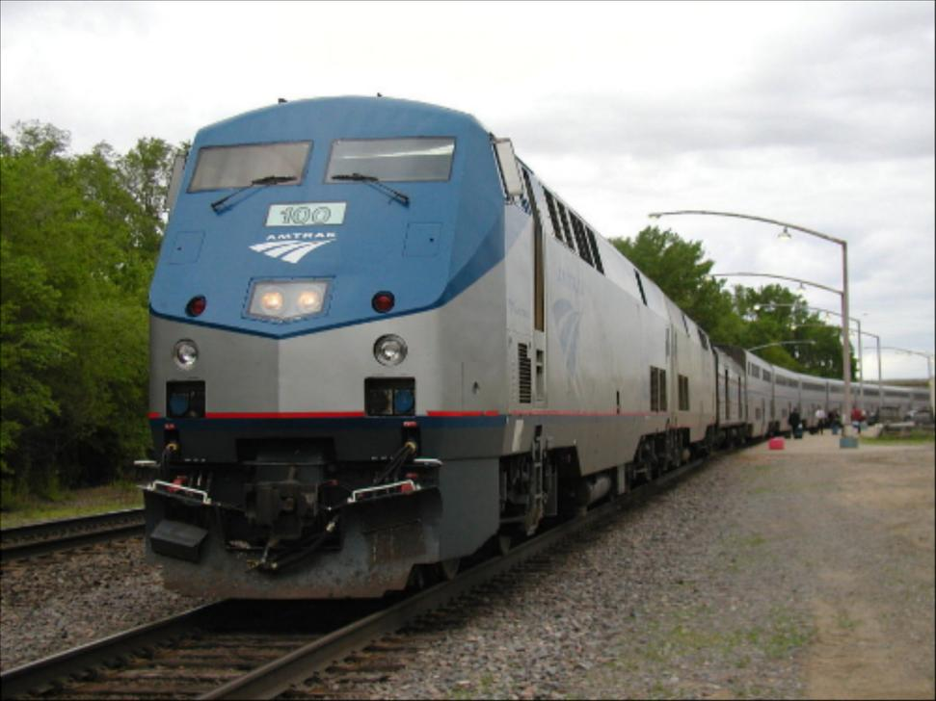
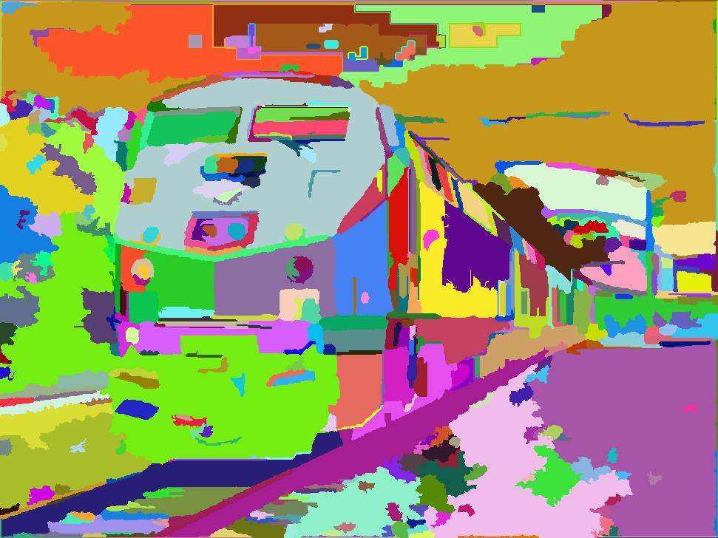
Example: Image segmentation
An image is divided into regions based on color or other appearance features
Each region is a set of pixels
The segmentation is a collection of regions, or a collection of sets of pixels

Slide 4
Sets of sets

Slide 5
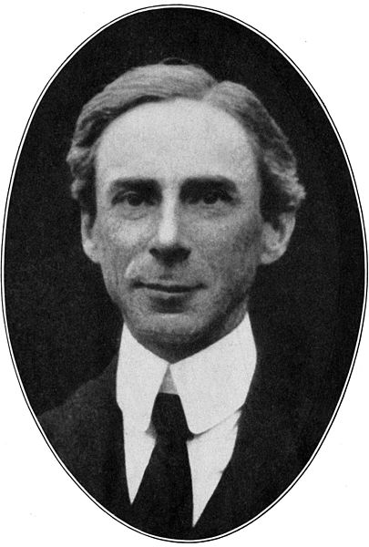
Russel’s paradox
If R is in R, then R cannot be in R.
If R is not in R, then R is in R!
“"Hardly anything more unfortunate can befall a scientific writer than to have one of the foundations of his edifice shaken after the work is finished. This was the position I was placed in by a letter of Mr. Bertrand Russell, just when the printing of this volume was nearing its completion.“
- Frege, in his Appendix to Vol. 2 of Grundgesetze
Led to axiomatization of set theory… Zermelo-Frankel

Slide 6
The powerset of set $S$ is the set of all possible subsets of $S$
Example: the powerset of $\left\{a, b, d\right\}$ is $\{∅,\left\{a\right\}, \left\{b\right\}, \left\{d\right\}, \left\{a,b\right\},\left\{a,d\right\},\left\{b,d\right\},\left\{a,b,d\right\}\}$
Example: the powerset of the set of pixels is the set of all possible image regions (including discontinuous regions)
If we have $n$ pixels, how many possible regions are there?

Slide 8
Partitions
There are 10 kinds of people: those who understand binary and those who don’t.
A partition of $A$ is a collection of non-empty subsets of $A$, such that each element of $A$ is contained by exactly one subset

Slide 9
Partitions with Finite Sets
A collection of sets $C$ is a partition of $A$
$C covers A$: $C_{1}∪C_{2}∪…∪C_{n}=A$
No overlap within elements of $C$: $C_{i}∩C_{j}=∅$ if $i≠j$
No element of $C$ is empty
The segmentation is a partition of the image pixels: the regions do not overlap, are non-empty, and their union includes all pixels

Slide 10
Partitions with Finite/Infinite Sets
A collection of sets is a partition of $A$ if
Example 1: The set of natural numbers can be partitioned into those between 0 and 9, 10 and 99, 100 and 999, ${10}^{k}$ and ${10}^{k+1}$-1, etc. (elements of each set have the same number of digits)
Example 2: Any elements of the set of real numbers that round to the same integer are in a set. The collection of these sets is a partition on the set of real numbers.

Slide 11
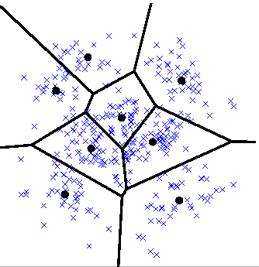
Partitions of continuous spaces
Quantization: map $R^{n}$ to a partition of $R^{n}$
Clustering
Decision trees
Represent any points that fall into each cell with an integer
Treat all points within a cell as the same
Represent points in cell with summary statistics, such as mean
Simplifies matching and function fitting

Slide 12
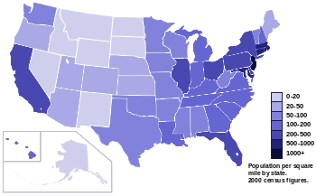
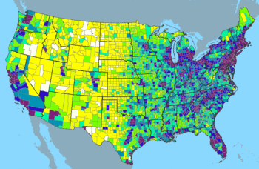
Partition of continuous space (R²)
Population density by state
Population density by county
Population distribution over area approximated by population within each state or county
Source: http://en.wikipedia.org/wiki/List_of_U.S._states_by_population_density

Slide 13
Things that are not partitions
$\{\left\{1, 2\right\}, \left\{2, 3\right\}\}$ is not a partition of $\{1,2,3\}$
$\{\left\{1\right\}, \left\{2, 3\right\},∅\}$ is not a partition of $\{1,2,3\}$
$\{\{natural x: x<5\}$, $\{natural x:x>5\}\}$ is not a partition of the natural numbers
$\{\{natural x: x≤5\}$, $\{natural x:x≥5\}\}$ is not a partition of the natural numbers
Notes:
Ex 1: overlap
Ex 2: contains empty set
Ex 3: does not contain all elements
Ex 4: overlap

Slide 14
Some nit-picky things to remember
Important to distinguish between a one-element set and an element: $\left\{3\right\}≠3$
Common programming error (e.g., function is expecting a set but gets a number)
Every powerset contains the empty set as an element
An element of a collection (or set of sets) is a set
The powerset of S forms a partial order under the subset relation

Slide 15
Equivalence relations and partitions

